Slide 1

The start of spring
Different definitions of seasons and their time period
We use the meterological definition given on SMHI:s webpage

Slide 2
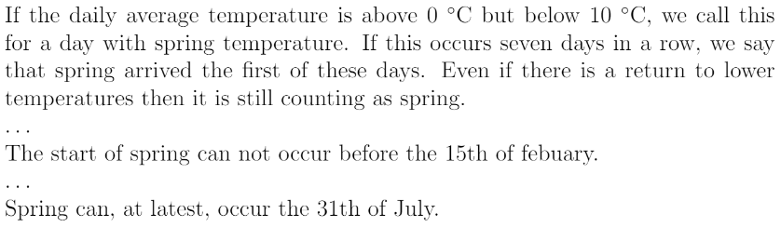
Meterological definition used

Slide 3
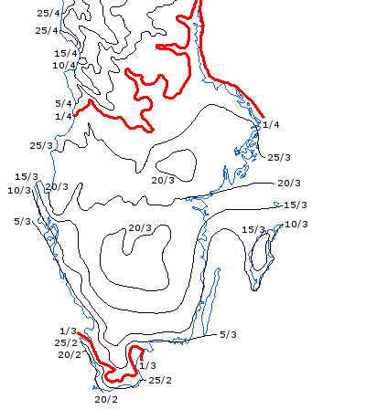
Map of spring arrival
Uppsala
Figure show the typical date of spring arrival (not only for 2013)
For Uppsala spring occur near the end of March
Source: https://www.smhi.se/vadret/vadret-i-sverige/arstidskarta/ank_var_2013.html

Slide 4
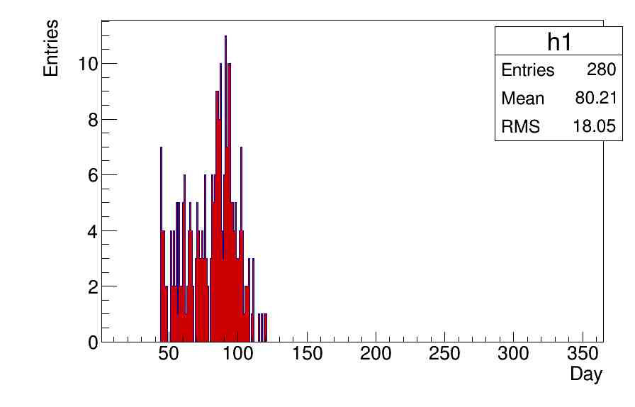
Histogram of spring dates
Days span from 1 to 365
Leap years are shifted by 1 day
Mean at day 80 represent 20th of March or 21th of March if it’s a leap year
Standard deviation roughly 2.5 weeks

Slide 5
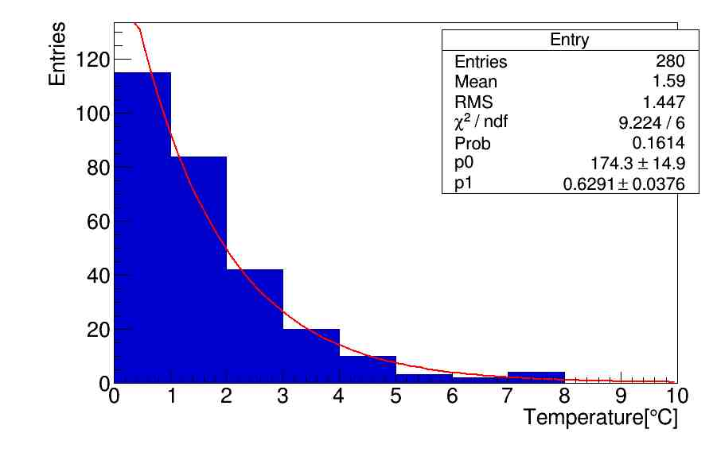

Temperature of determined dates
Gradual increase in temperature yield decaying shape
Fit using a exponential function
p0 represent α
p1 represent λ
$$f\left(x\right)=αe^{−λx}$$

Slide 6

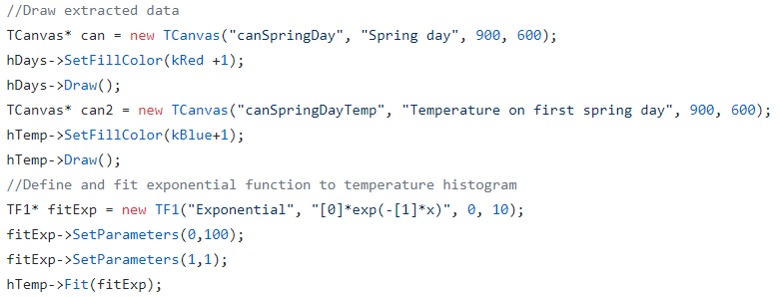
Code
Create two histograms
Read data (+check conditions)
Plot data

